Slide 1
INTELLECTUAL PROPERTY RIGHTS INFRINGEMENT IN THE 21ST CENTURY:
Agenda for the Nigerian Bar
17 DECEMBER 2025
dg@copyright.gov.ng
080 2323 7677
John O. Asein, Ph.D.
Director-General, Nigerian Copyright Commission

Slide 2
IBADAN: HOME OF THE (REAL) NBA
I am particularly delighted to speak at the Platinum Jubilee of the Ibadan Branch of the Nigerian Bar Association – the Premier Bar, having spent my most active years as a teenager and young adult here.
My special interest came while I was revising the last edition of my Introduction to Nigerian Legal System, and I came across the historical account of David Olayinka Ajayi in his paper “Ibadan and the Beginning of the Nigerian Bar Association”.
I got to know that the it was here in Ibadan that what is today the Nigerian Bar Association as an independent body of lawyers led by an elected President and not tied to the apron strings of government as conceived under the Legal Practitioners Ordinance (No. 57) of 1933 under which the Attorney-General was President and the most senior lawyer on the roll was Chairman.

Slide 3
Our Goal . . .
To stimulate discussions about the place of lawyers in sharpening Nigeria’s IP system as a to meet the challenges of the 21st Century and be a catalyst for growth

Slide 4
OUR BLURRED VIEW OF THE 21ST CENTURY
Time waits for no one and the 21st Century is almost one-quarter gone!
It will continue to run with or without us!
The topic may be misleading – Attempting to discuss the IP rights infringement in the 21st Century may suggest that the we have successfully discharged issues from the 20th Century.
Unfortunately, Nigerian Intellectual Property is like old wine in new wine skin

Slide 5
Nearing the Quarter of a Century Mark
As we stand at the threshold of 2025, with nearly a quarter of this century behind us, it is time to reflect on where we stand in the global knowledge economy—and more importantly, how we are faring in the use of where we are and how we need to progress in the use of Intellectual Property (IP).
As the world evolves into an economy increasingly driven by creativity, innovation, and intellectual capital, the role of intellectual property (IP) has become more critical than ever. In this context, the Nigerian Bar Association and the broader legal profession have a profound responsibility to ensure that our IP framework is not just functional but transformative.
While we reflect on the challenges and opportunities within Nigeria’s IP ecosystem, it is also vital to draw lessons from other African countries that have successfully leveraged their intellectual property frameworks for economic growth and global competitiveness.

Slide 6
THE 21ST CENTURY REVOLUTIONS
However good the highway might be, the ease and speed of our ride would would still depend on the vehicle we choose.
There is a huge difference between a bicycle and a car travelling on the same road.

Slide 7
The New Innovation and Creativity Landscape
Innovation and IP are the engines that power today’s global economy especially as the world transits from the information revolution which saw the coming of the computer through the information revolution where we are witnessing the ascendancy of artificial intelligence, quantum computing and other emerging super-fast technologies.
It is generally agreed that humanity is still in the 4th Industrial Revolution while the 5th Revolution is imminent with more human-technology interaction.
Considering the sophistication and speed of the new Revolution, the next phase will come sooner than we expect. For centuries, man always seem to have control of his inventions. But with Artificial Revolution it would seem that man has finally invented a system created in his own image, with neural capacity, that is able to mimick him and may be beaten him in his own game. that learn, think and is able to match human intelligence.

Slide 8
The New Innovation and Creativity Landscape
Nigeria has shown strength in the creative landscape. For instance, in the area of music, as reported by Spotify, Nigerian artists earned royalty payment of N11 Billion in 2011 and N25 Billion in 2023. The approved CMO, in 2022 declared a distribution of over ₦300 Million as royalties to right holders.
The publishing industry in the first quarter of 2023 saw a marginal increase of 0.25% in revenue from N10.11 Billion to N10.14 Billion in the same quarter of 2022.
The audiovisual and music sectors together accounted for roughly N154 Billion (roughly US$197.6 million) of Nigeria's GDP in 2023.
In 2023, the box office in Nigeria grossed about N7.24 Billion, improving on the 2022 record of N6.94 Billion and N4.74 Billion in 2021.
The CMO for audiovisual works, AVRS, distributed a meagre collection of N18.68 Million to its members in 2023.
The figures on the innovation side is less impressive.

Slide 9
The New Innovation and Creativity Landscape
Nigeria ranks 113th on the 2024 WIPO Global Innovation Index, behind Mauritius (55th); South Africa (69th); Botswana (87th); Cape Verde (90th), Senegal (92nd); Kenya (96th); Ghana (101st); Namibia (102nd); Rwanda (104th); and Côte d’Ivoire (112nd). Of course, countries like Switzerland, Sweden, and the United States dominate the top spots​.
The challenges are clear: Nigeria’s score of 18.44 points (out of 100) is low, compared to the global average of 33.17 points. This reflects a weakness in R&D, infrastructure, and business sophistication​. Our R&D spending was as low as 0.28% of GDP, while patent filings by residents was a mere 410 in 2020.
These numbers do not merely represent rankings. They are evidence of missed opportunities which impact on the economy. Global leaders in IP also leverage on their creative and innovation sectors for job creation, wealth generation and global competitiveness. Without significant and urgent reform, Nigeria will be left behind in the 21st Century.

Slide 10
Lessons from Other African Countries
Nigeria has to make a deliberate policy choices and put in place appropriate strategies to become compete effectively in the 21st Century. We must find our most competitive edges harness our potentials and beyond the creative landscape.
Mauritius
How did this country with a population of 1.26 million manage to rank 55th in the world and 1st in Africa on the Global Innovation Index? It has managed to transition from a low-income economy to an upper-middle-income economy in just a few decades.
It created a predictable and investor-friendly IP system that has focused on creating a business-friendly environment by establishing clear IP policies and aligning its framework with international agreements to attract global capital.
The country has invested in sectors like biotechnology, financial technology, and creative industries by providing strong protections for patents, trademarks, and copyright.

Slide 11
Lessons from Other African Countries
South Africa
Ranked 69th globally and 2nd in Africa, has the Companies and Intellectual Property Commission (CIPC) and boasts of a well-developed IP regime and IP laws – copyright, trade marks, patents and designs – are considered to be relatively modern and aligned with global best practices.
The country has recorded advancements in the fields of pharmaceuticals, agriculture, and renewable energy
Kenya
Ranked 96th globally and 3rd in Africa, Kenya has prioritized IP protection as part of its Vision 2030 economic development plan and has done well with its industrial property rights protection. The success of the mobile money platform, M-Pesa, has been globally acknowledged as helped by strong IP protection.

Slide 12
Lessons from Other African Countries
Rwanda
Ranked at 104 globally, Rwanda is believed to have demonstrated a focused approach to IP administration and enforcement to yield significant results.
It may not be as high-performing country like Mauritius, South Africa and Kenya, but it has managed to prioritize capacity building, including the training of IP professionals and judges to handle complex IP cases. Rwanda has also made strides in copyright enforcement, supporting the growth of its nascent creative economy.
Nigeria can learn from these countris in prioritising policies, statutes, support for industries and their harnessing of the IP system as well as the availability of effective professional and institutional support system to enforce and help right owners to better use the IP. This will require more strategic approach to the building of institutions and creating the needed awareness IP and its sustainable use.

Slide 13
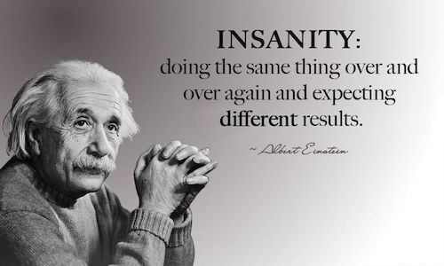
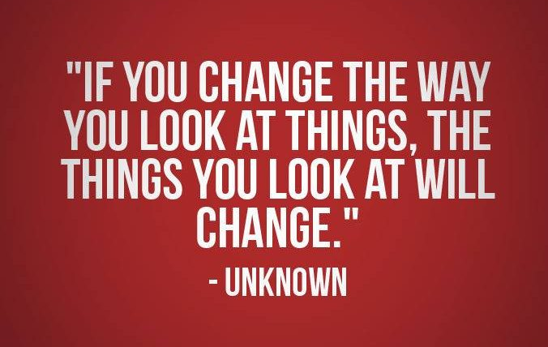
Reflections on Missed Opportunities

Slide 14
Any Lessons from Our Missed Opportunities?
The turn of the millennium offered us a chance to recalibrate but we did not!
As the world prepared for the so-called "millennium bug," Nigeria (like many other countries) may have been more obssessed with the IT infrastructure and failed to invest sufficiently in the broader IP support framework needed to secure the digital and knowledge economy. We built roads but forgot to upgrade the vehicles that would run on them.
This oversight may have resulted in a system where our creatives and innovators continue to face challenges protecting their work and reaping the full benefits of their intellectual investment. That I call the IP gap in our creativity and innovation landscape.
While Nigeria manageed to overhaul and enact a new Copyright Act in March 2023, the industrial property lane is still begging for renovation, despite the patchwork done with the Business Facilitation (Miscellaneous Provisions) Act, 2022, also signed into law in 2023. Even the Copyright Act is already begging for revision.

Slide 15
The Economic Case for IP Reform
The economic benefits of a strong IP framework are clear. Nations that prioritize IP report higher contributions from their creative and industrial sectors to GDP. For instance:
South Korea and Japan have built entire industries — like semiconductors and automotive manufacturing — on robust IP foundations.
The United States sees over $6 trillion annually in economic output from IP-intensive industries, accounting for nearly 40% of its GDP.
For Nigeria, a recalibrated IP system could:
Increase national patent filings, currently at 410, by fostering innovation in universities and research institutions​.
Increase trade mark filings by appropriate administrative initive.
Encouraging.
Reduce losses from piracy and poor right management, which currently deprives our music and film industries of millions of dollars annually.
Attract foreign direct investment by signaling that Nigeria is a safe and lucrative place to innovate and create.

Slide 16
The Economic Case for IP Reform
For Nigeria, the creative sector – led by Nollywood and Afrobeat – already contributes an estimated $7 billion annually to the country’s GDP.
Yet, inadequate IP protections means that much of this potential remains untapped, with creators losing revenue to piracy, weak enforcement mechanisms​, inadequate professional support, including a hugely illformed Bar and Bench, lack of sustained political will and a responsive legislative backing.
A robust IP framework is more than simply protecting rights. It would unlock economic growth across multiple sectors. A strong patent system, for example, would encourage innovation by universities, research institutions, and startups, leading to new technologies and industries.
It would also attract foreign direct investment, as investors prioritize countries with clear and enforceable IP laws.

Slide 17
The Economic Case for IP Reform
With the support of WIPO, Nigeria has developed an IP Policy and Strategy document which is awaiting adoption by the Federal Executive Council.
This is not to say that the Policy would necessarily bring about the needed change. But it would at least provide the roadmap.
Each role player and stakeholder must be awake and true to their responsibilites under the Policy and follow through on the strategy to achieve the objectives.

Slide 18
Call to Action in the 21st Century
TOMORROW IS HERE!!

Slide 19
Imperatives for Nigeria and the Bar
African countries leveraging IP as a tool for economic growth share common strategies:
Modernizing Legal Frameworks: Countries like Mauritius and South Africa have ensured their IP laws are aligned with international treaties, which simplifies cross-border commerce and attracts investment. Nigeria should set a mark to overhaul and modernize its entire IP system by end of 2025. This should include operationalising all relevant treaties and finding appropriate responses to regional and subregional initiatives.
Infrastructure Investment: Just as we need physical highways for commerce, we need the institutional “highways” for intellectual property. These include streamlined patent offices, digital rights management systems, and accessible IP databases.
Institutional Strengthening: Kenya and Rwanda demonstrate the importance of strong, well-funded IP agencies. Nigeria’s IP institutions, such as the Nigerian Copyright Commission, must be empowered with resources and training to better enforce rights.

Slide 20
Imperatives for Nigeria and the Bar
Fostering Innovation Ecosystems: Countries like Kenya have created ecosystems that support innovation through public-private partnerships, targeted funding, and incubation hubs. Nigeria can replicate this to support its growing tech and creative industries.
Capacity Building: As illustrated by the Rwandan experience, Nigeria should focus more on training legal professionals is a key lesson for Nigeria. A well-trained staff of regulatory agencies, IP Bar and Bench are critical to resolving disputes and ensuring confidence in the IP system. Without capable personnel, even the best policies and strategies will fail.
Public-Private Partnerships: Collaboration between government, academia, and industry can fast-track innovation. Incentives for R&D, grants for startups, and support for university-industry linkages are proven strategies that we must adopt.
Global Integration: Nigeria must join global IP networks and strengthen its participation in international agreements. This will enhance market access for Nigerian innovators and provide global recognition for our IP assets.

Slide 21
Imperatives for Nigeria and the Bar
The Role of the Bar in IP Transformation
The Nigerian Bar Association (NBA) and the legal profession are central to this transformation. As the gatekeepers of law, advocates of justice, and defenders of rights, legal practitioners play a critical role in shaping a functional and efficient IP system. Here are key areas where the Bar must step in:
1. Advocacy for Legal Reform
The Bar must champion the modernization of Nigeria’s IP laws. By 2025, Nigeria should fully align its IP framework with international standards, covering copyright, patents, trademarks, and designs. Lawyers, as policy influencers, must push for the adoption of treaties such as the Patent Cooperation Treaty (PCT) and advocate for policies that address emerging challenges like artificial intelligence, biotechnology, and the digital economy.

Slide 22
Imperatives for Nigeria and the Bar
2. Capacity Building and Specialization
For Nigeria’s IP system to thrive, the legal profession itself must evolve. There is a pressing need for IP-specialized lawyers, capable of navigating the complexities of both domestic and international IP laws. The Bar can lead by organizing training programs, certifications, and workshops to build expertise in areas such as patent litigation, digital rights management, and licensing agreements.
3. Strengthening Institutions
The effectiveness of IP laws depends on the institutions that enforce them. The Nigerian Bar can work closely with agencies like the Nigerian Copyright Commission (NCC) to enhance their operational capacity. This includes ensuring that these agencies have access to the resources and expertise needed to enforce rights effectively in both physical and digital spaces.

Slide 23
Imperatives for the Bar
4. Providing Legal Support to Creatives and Innovators
Creators, entrepreneurs, and innovators often lack the legal knowledge or resources to protect their IP. The Bar can establish pro bono programs or legal clinics to assist underrepresented groups, including local artisans, startups, and small businesses, in understanding and enforcing their IP rights.
5. Driving Public Awareness
An efficient IP system requires a society that understands and respects intellectual property rights. The Bar can spearhead public awareness campaigns, educating businesses, creators, and the public about the economic and social benefits of robust IP protections.
6. Litigation and Precedent Setting
Through strategic litigation, lawyers can set important precedents that strengthen the enforcement of IP rights in Nigeria. By tackling cases of piracy, counterfeiting, and patent infringement, the Bar can help establish a legal environment where rights holders feel secure in investing in innovation and creativity.

Slide 24
Imperatives for the Bar
7. Supporting the Implementation of the National IP Policy
The recently developed National IP Policy and Strategy must move beyond the Federal Executive Council to actual implementation. The Bar can play a watchdog role, ensuring accountability and adherence to timelines.
8. Promoting Innovation Clusters
Lawyers can facilitate partnerships between academia, government, and the private sector to create hubs of innovation where ideas can be protected and commercialized.
9. Encouraging International Engagement
The Bar can help integrate Nigeria into global IP frameworks, ensuring our creators and innovators are protected on the world stage.
10. Call to Leadership
The Nigerian Bar must rise to its responsibility as a key stakeholder in the IP ecosystem and contribute to the navigating Nigeria through the 21st century and unlock the full potentials of our creative and innovative economy as a nation.

Slide 25
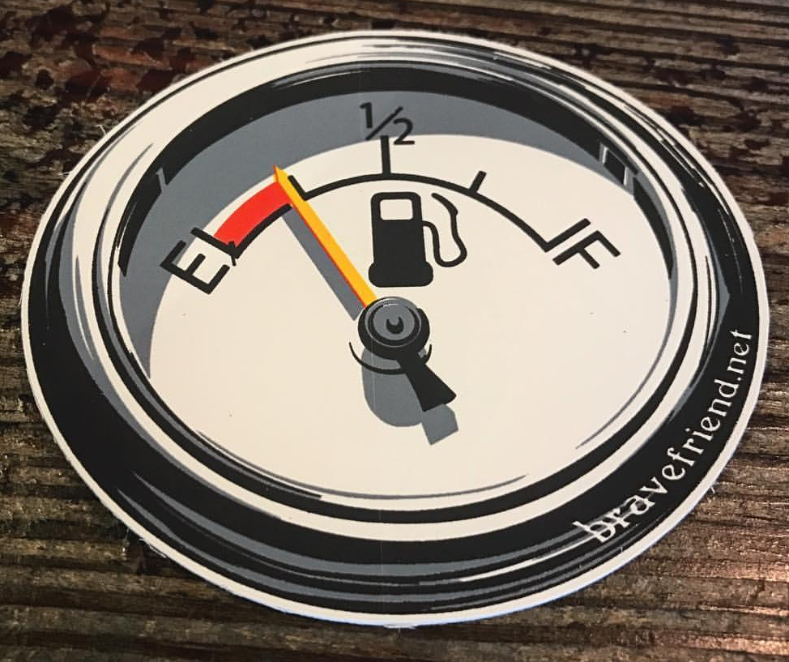
Finally. . .
We are almost 25% down the 21st Century highway!
As the world transitions into an economy driven by knowledge, creativity, and innovation, Nigeria cannot afford to stand still.
If we recalibrate our IP system now, the benefits will extend far beyond rankings. We will see an innovation-driven economy where creatives and inventors are empowered, industries thrive, and Nigeria takes its rightful place on the global stage.
This is not just a legal or policy issue; it is an economic and moral imperative. Let us act boldly and swiftly. The time for half-measures is over and now is the time to secure Nigeria’s future.
Let us act with urgency and boldness, for the future will not wait for us. Thank you.

Slide 26
THANK
YOU
john.asein@copyright.gov.ng
dg@copyright.gov.ng
+234 80 2323 7677
John O. Asein, Ph.D.
Director-General, Nigerian Copyright Commission

