Slide 1
The Lawful Use of
Robotics and Artificial Intelligence
in Legal Practice in Nigeria
Dr. Olusola Sayeed Ayoola, Ph.D (Manc.), M.Sc (Manc.), MIET, MNSE, MNCS
CEO | Robotics and Artificial Intelligence Nigeria (RAIN)
AT THE 70TH ANNIVERSARY OF THE NIGERIAN BAR ASSOCIATION, IBADAN BRANCH, 17TH DECEMBER, 2024

Slide 2
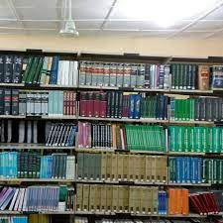
THE GOLDEN ERA OF LEGAL PRACTICE
I grew up in the embrace
of Learned People:
Hon. Justice Olu Ayoola (blessed memory)
Hon. Justice Dr Mrs Ruqayat Ayoola, JCA.
Listening and Typing words
like “res judicata”
“prima facie”
“jurisprudence”
Law to me was $Logic = Evidence + Rules + Precedence+ Philosophy$
Nostalgia of what legal practice was in the past.

Slide 3
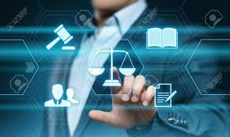
TIMES ARE EVOLVING
Welcome to 4IR where Emerging Technologies are disrupting coveted professions.
We are moving from Human to Machine Dependence.
Migration from Hard Work to Smart Work.
“Evolve with the time or Perish”
Humans who have the capacity to manage this machines will remain relevant.

Slide 4
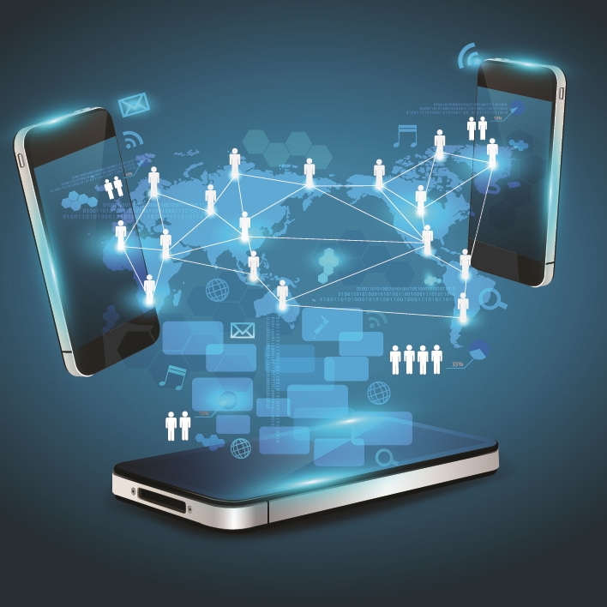
THE NEW AGE
Micro-Chips and Battery technologies are aggressively advancing.
We see it in the fintech world of cryptocurrency.
We see it in overnight celebrities and virility.
We see it in invincibility of cyber bullies and hackers.
With smart devices now having a mind of their own over our data.

Slide 5
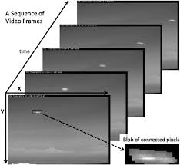
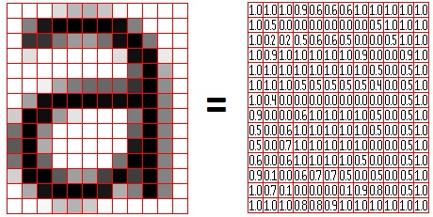
The Science Behind the Technology
Every work of art is an arrangement of “1”s and “0”s.
Computer Algorithms can detect their structure, patterns, relationships.
Powerful computation platforms can work on real-time data
Your Churn out Huge Chunks of Data every Second.
Daily chats, emails, virtual meetings, videos and location.

Slide 6
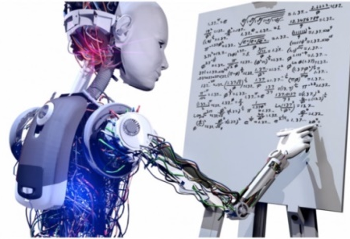
What is Artificial Intelligence ?
Artificial intelligence, or AI, is the ability of computers and machines to simulate human intelligence and problem-solving capabilities.
Artificial intelligence (AI) is the ability of a computer based machine to collect data from its environment, process the data using heuristic algorithms in order to understand aspects of its environment and make informed decisions without necessary human interference.

Slide 7
CLASSES of AI
PREDICTIVE AI
GENERATIVE AI
SUPERVISED LEARNING
GENERATIVE ADVERSARIAL NETWORK
GEMINI
LLAMA
MIDJOURNEY
UNSUPERVISED LEARNING
RECOMMENDER SYSTEM
REINFORCEMENT LEARNING
TIME SERIES FORECASTING
CHATGPT
GENERATIVE PRE-TRAINED MODELS
EXAMPLES:
https://www.techtarget.com/searchenterpriseai/tip/4-main-types-of-AI-explained

Slide 8
…an example of a computational algorithm for decisions
Decision to Promote =
2 * Hardworking
+ 1.5 * Punctuality
- 1.2 * Queries
+ 1.5 * Current Level
+ 4 * Knowledge Displayed
+ 2 * Adaptability and Learning Agility
+ 3 * Leadership Skills
+ 2 * Collaboration and Teamwork
+ 2 * Initiative and Proactiveness
+ 1.5 * Communication Skills
+ 2 * Project Management Skills
- 0.03 * Current Salary

Slide 9
Types of AI
Based on Capabilities
Narrow AI
General AI
Super AI
Able to complete very specific actions.
Able to learn, think and perform at similar levels to humans
Able to surpass the knowledge and capabilities of humans
Image recognition
Virtual assistants
Self-driving cars
Generative Adversarial
Network (GAN)
Still Largely Theoretical
Needs to be dynamic and able to adapt on its own
https://www.techtarget.com/searchenterpriseai/tip/4-main-types-of-AI-explained
Generative Pre-Trained
Transformer (GPT)

Slide 10
What is a Robot ?
Electro-mechanical systems that can operate without the direct involvement of humans.
Laced with sensors for detecting changes in the environment, with high resolution and sensitivity.
Can independently collect their own data from the environment.
Take decisions of high accuracy.

Slide 11
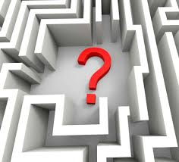
THE QUESTION
With humans getting lazier and trusting less:
What is the role of AI and Robotics in the Legal Practice in Nigeria?
Would it seek to displace us or enhance our works?
What aspects can it relieve us off completely?
Are we prepared for what the future holds?
What is the Lawful Use of Robotics and AI
in Legal Practice in Nigeria?
Who is to provide these answers?

Slide 12
MY OBJECTION
Do the lawyers want to drag me to the gallows where data privacy, protection, ownership rights, and sovereignty will be dissected?
I seek to limit myself to speaking about the Use of AI and Robotics in Legal Practice
While allowing learned discussants the opportunity of discussing the Lawful aspect of the usage.
Wrong and Unlawful are two distinct terminologies.
He who asserts must prove, citing relevant laws or lacuna.
I seek permission to proceed.

Slide 13
CAVEAT
AGREED:
AI AND ROBOTICS ARE CONTINUALLY EVOLVING.
THEY ARE NOT PERFECT YET.
THEY CAN FAIL.
THEY DEPEND ON DATA QUALITY AND LIMITATIONS OF PROGRAMMING
NO MATTER WHAT, THEY SHOULD REMAIN SUPERVISED BY THE HUMAN EXPERTS.
IT IS THIS COLLABORATION THAT WE SEEK; BETWEEN HUMAN AND MACHINE

Slide 14
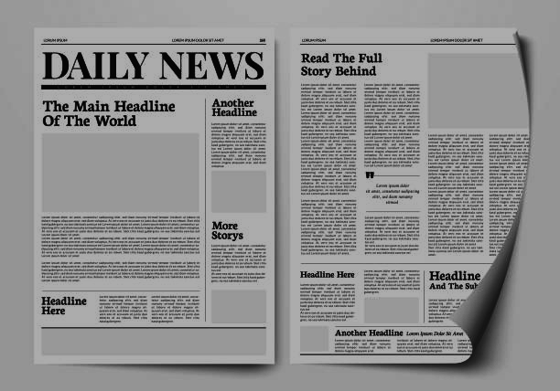
Roberto Mata v. Avianca Inc Manhattan, U.S.A 2023
Roberto Mata sued Avianca Airlines, alleging personal injuries from a metal serving cart.
The plaintiff's lawyer used ChatGPT to research case law.
The AI confidently cited six precedents, which, upon review, turned out to be entirely fabricated.
The cases it provided—complete with fictitious citations, judges, and details—never existed.
The Counsels were fined over $5,000.
https://apnews.com/article/artificial-intelligence-chatgpt-courts-e15023d7e6fdf4f099aa122437dbb59b

Slide 15
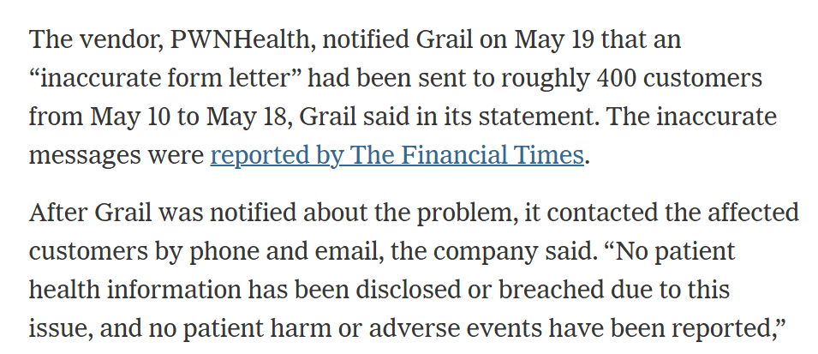
GRAIL Software issues false cancer
warnings to 400 customers
2023
https://www.nytimes.com/2023/06/04/business/grail-blood-test-mistake-cancer.html

Slide 16
APPLICATION OF ROBOTICS AND AI IN LEGAL PRACTICE
Not all of Artificial Intelligence is on ChatGPT.
Autonomous, impromptu decision making based on environmental events and data is one of the most critical purpose of AI performed by Predictive AI.
Hence the need to work closely with local AI developers for proper integration of AI services into our Legal System.
We shall highlight 10 areas of Application.

Slide 17
LAWFUL USE 1
Managing Registry Records
Probate, Lands, Litigation
From arbiter to habitat of legacy records.
A repository of undisputable Video Based Records e.g. land ownership transfers + drones
Electoral Materials Inspection
In addition to Bi-Modal Voter Accreditation System.
Need to beat Time Limit Deadline for Tribunal Matters
Robotic Automated Scanning Platforms.
Computer Vision Based OCR.
Detection and Sorting of abnormal Data
Smart Court Admin and Case Assignment
Case Scheduling, Tracking Availabilities, Case Specifics and automated notifications. Bailiff Support. NLP algorithms can analyze vast amounts of data to identify case similarities, duplication or protocol breach.
Legal Research Support and Brief Preparation
Case Analysis, Devil Advocates on prepared arguments, & Error Reductions.
Use existing AI solutions such as ChatGPT, Grammarly, Gemini etc.
Build peculiar NLP based web platforms for managing repetitive document preparation.

Slide 18
LAWFUL USE 2
Legal Process Workflow Automation for Lawyers
Automating Chamber Work Flow and Schedules. Tracking Service on the other party. Digitizing the NBA Seal of Lawyers for Digital Documents.
Robot Process Automation through Desktop or Mobile apps.
Smarter Arbitration
Unbiased and Cost Effective Adjudication for Parties that opt for it.
Predictive AI’s Supervised Learning and Large Language Models can analyze vast datasets, arguments and records to detect anomalies, fraudulent activities and resolve conflicts.
Enhanced Personalized Legal EdTech
Use of Generative AI to develop personal assessment platforms for law trainees through random generation and assessment of case briefs.
A combination of all AI tools is necessary for Edtech development.
Overall Reduction in Conflict.
Is an automated world with reduced human interaction a recipe for peace?
Self-Driving Cars result in less accidents or traffic violations.
AI enhanced document drafting results in less Defamation and Aggressive Language.
Reduced litigation promotes quality.

Slide 19
LAWFUL USE 3
Proof against Fake Evidence or AI Abuse
Only AI can detect AI.
AI can detect patterns in audio, video or text communication.
AI based tools can cross-check large texts for valid or invalid citations.
Relieving the court the burden of detection.
Parole System for Prison Decongestion
Parole system can be made more effective through the use of GPS Location trackers, battery level detectors and enforcement mechanisms.
This bothers on the development of Internet/GSM of Things hardware.

Slide 20
Challenges for the Future
Are we equipped with adequate power and internet connectivity?
Are our courts and law chambers digital inclined:
Facility wise
Knowledge and Training Wise
Would this widen the digital gap in our profession?
Should our Law School priorities Emerging Technologies Education?
Should our Rule Books be revised to guide on the role and abuse of emerging technologies in Legal Practice?
Will you invest heavily now in the new mode of practice?

Slide 21
Action Plans
Invest in training for human capacity development.
Invest in Solid Infrastructure such as Data Centres dedicated to Law related Data.
Court Judgments and Court Processes should now be in Digital text formats, not Scanned Images.
Policy Makers must promote Open Source Platforms for accessing, referencing and validating Court Judgments.
This will also aid the advancement of well trained AI solutions

Slide 22
CONCLUSION
We still need humans in our Legal system as:
AI is not ultimately perfect yet and Humanity Component remains critical to justice.
Need for healthy collaboration between us and machines.
Keep ChatGPT close, but your local AI Engineers closer.
With RoboLawyers and RoboJudges making headlines in some countries, it is only a matter of time before our legislators will determine it an alternative dispute resolution mechanism.
The competition is Global, let’s protect our marketplace

